Slide 1
Growing Healthy Communities & Worksites

Slide 2
ArCOP IS GROWING HEALTHY COMMUNITIES
Healthier environments produce healthier people. Healthier people produce greater economic outputs, consume fewer healthcare resources and lead better, longer lives.
The Coalition currently has
over 1400 members and
more than 100 partner institutions.
Learn more: arkansasobesity.org
Notes:
The Arkansas Coalition for Obesity Prevention (ArCOP) is Growing Healthy Communities (GHC) by helping Arkansans change their environments to make the healthy choice the easy choice. ArCOP’s mission is to improve the health of all Arkansas communities by increasing access to physical activity and healthy eating to reduce and prevent obesity. GHC, the Coalition’s project initiative, fosters these outcomes through proven, disciplined & replicable methods.
ArCOP strives to welcome all those interested by making membership free and partnership simple. The only requirement: a desire for a healthier Arkansas.

Slide 3
Growing Healthy Communities
What is Growing Healthy Communities?
Growing Healthy Communities (GHC) is an initiative of the Arkansas Coalition for Obesity Prevention (ArCOP). Since 2009, the Coalition has been helping Arkansas communities build capacity to reduce obesity by increasing access to physical activity and healthy foods, as well as implementing environmental, system, and policy changes that support healthy living.

Slide 4
Up from the Roots
https://youtu.be/dO6qMeFJtTE

Slide 5
Healthy cities are economically secure cities.

Slide 6
ArCOP IS GROWING HEALTHY COMMUNITIES
114 Total Attendance
40 mayors (9 host mayors & 31 guest mayors)
21 mayoral guests/staff/council members
37 community members

Slide 7
www.arkansasobesity.org/ghc/3m/toolkit/

Slide 8
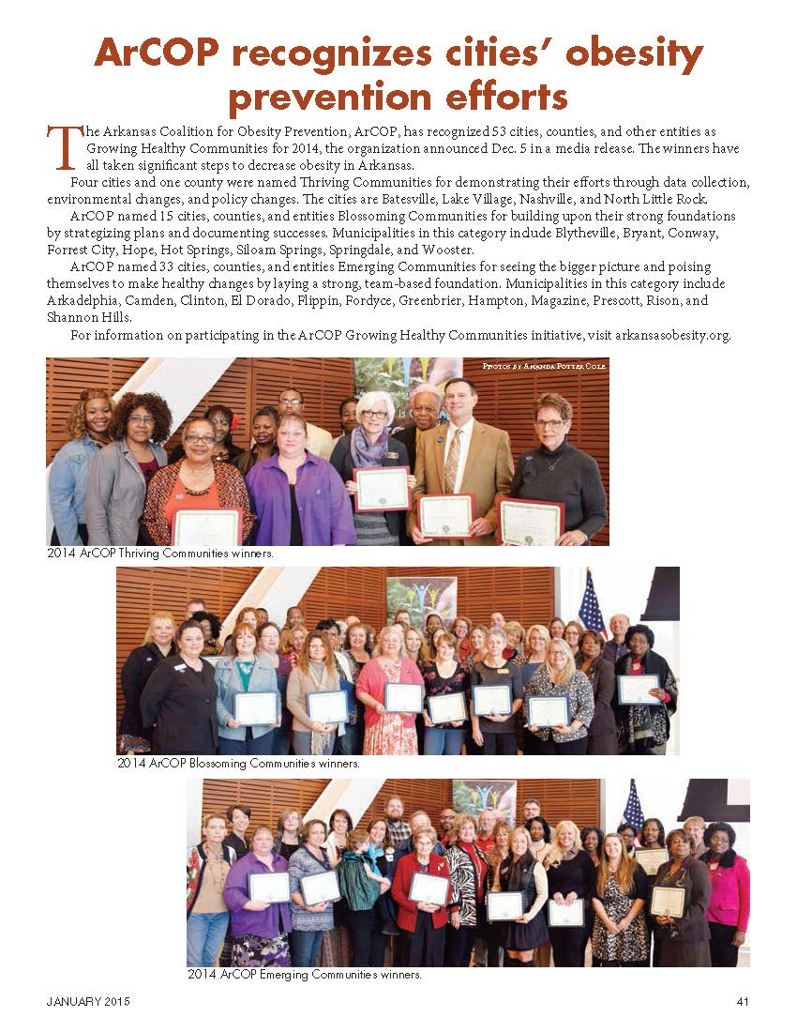
Cities & Towns
January 2015

Slide 9
Growing Healthy Communities Recognition Levels
Emerging Communities
Blossoming Communities
Thriving Communities

Slide 10
Growing Healthy Communities Recognition Levels
Emerging Communities
Communities who receive the “Emerging” designation, are laying a strong foundation with a team of at least five individuals.
GHC teams are made up of diverse stakeholders who are interested in creating healthier communities: elected officials, fundraisers, community volunteers and professionals in education, health-care, civic government and more.
HOW TO MAINTAIN EMERGING STATUS
The “Emerging” designation is intended to recognize communities that see the “bigger picture” and are in the process of laying a strong foundation through engaging and educating stakeholders.

Slide 11
Emerging Communities
City of Arkadelphia
City of Camden
City of Clinton
City of El Dorado
City of Flippin
City of Fordyce
City of Greenbrier
City of Hampton
City of Magazine
City of Marianna
City of Prescott
City of Rison
City of Shannon Hills
Arkansas County
Marion County
Searcy County
Big Dam Bridge Foundation Neighborhood in the City of North Little Rock
Bradford School District Neighborhood
Central Little Rock Neighborhood
Dollarway School District Neighborhood
Fayetteville Public Schools Neighborhood
First Baptist Military Heights “Main Street Get FIT Initiative” Neighborhood in the City of North Little Rock
Friendship Community Care Neighborhood in the City of Bryant
Harp Elementary School Neighborhood in the City of Springdale
Lamar School District Neighborhood
New Addition Development Corp. Neighborhood in the City of Nashville
North Little Rock School District Neighborhood
Promise Garden Park at 12th and Peyton Neighborhood in the City of Little Rock
South Central Service Cooperative Neighborhood in the City of Camden
South Fayetteville Neighborhood
Spring River Area Neighborhood
Tri Cycle Farms Neighborhood in the City of Fayetteville
White River Women’s Shelter Neighborhood

Slide 12
Growing Healthy Communities Recognition Levels
Blossoming Communities
Communities that receive the “Blossoming” designation build upon the requirements of Emerging Communities and also:
Provide a checklist community highlights.
Strategize plans for change.
Document successes & lessons learned.
Develop a strategic action plan that will help your community address concerns related to increasing access to healthy foods & physical activity. Strategic plans guide the direction community members take towards a clear, unified vision forward. Even better: ArCOP provides tools & guidance to assist communities with such planning!
Documenting and publicizing success stories can rally community members and help them see that positive change is within reach! Publicizing projects helps increase success through maximized community use and/or participation.
Discussing & tracking lessons learned can help community teams make improvements even faster by identifying what went well and what can be improved.
HOW TO MAINTAIN BLOSSOMING STATUS
The “Blossoming” designation is intended to recognize communities that see the “bigger picture” and are actively working towards positive change.

Slide 13
Blossoming Communities
City of Blytheville
City of Bryant
City of Conway
City of Forrest City
City of Hope
City of Hot Springs
City of Siloam Springs
City of Springdale
City of Wooster
Jefferson County
Woodruff County
Boone County Diabetes Collaborative Neighborhood
Cedar Ridge School District Neighborhood in the City of Charlotte
Ralphe Bunche Neighborhood Association in the City of Benton
UALR’s University District Neighborhood in the City of Little Rock

Slide 14
Growing Healthy Communities Recognition Levels
Thriving Communities
Communities that receive the “Thriving” designation build upon the requirements of Blossoming Communities and also:
Demonstrate change through data.
Demonstrate environmental- and policy-level change.
ArCOP’s goal of a healthier Arkansas starts with individual communities. Providing data and demonstrating how your community’s efforts make positive change helps Arkansas measure statewide improvement. A community’s ability to make lasting change to both the environment and public policies is a sign of success and sustainability.
HOW TO MAINTAIN THRIVING STATUS
The “Thriving” designation is ArCOP’s “gold standard” in Growing Healthy Communities and is intended to recognize communities that see the “bigger picture” and are actively making measurable change.

Slide 15
Thriving Communities
City of Batesville
City of Lake Village
City of Nashville
City of North Little Rock
Boone County

Slide 16
Growing Healthy Worksites Work@Health
Module 1: Making the Business Case, will provide you with key arguments regarding the “Why” of worksite health.
Health Cost Management Argument
Productivity Argument
Great Place to Work Argument

Slide 17
Growing Healthy Worksites Work@Health
Module 2: Assessing Your Worksite, discusses the need and value of assessing your employee population and your organization as a whole.

Slide 18
Growing Healthy Worksites Work@Health
Module 3: Building Leadership Support, addresses the value of having an inclusive leadership network involving senior management, middle/supervisory management, and lay leaders.

Slide 19
Growing Healthy Worksites Work@Health
Module 4: Developing Policy, Benefit, and Environmental Supports, reviews the importance of leveraging health-related policies, benefits, and environmental supports for removing barriers to employee engagement in health-related activities and programs.

Slide 20
Growing Healthy Worksites Work@Health
Module 5: Designing Effective Communications, reviews the importance of communicating your program through a variety of channels as well as creating your own unique brand.

Slide 21
Growing Healthy Worksites Work@Health
Module 6: Evaluating Your Program, addresses the value of establishing an evaluation process/plan before you implement your program and how to establish baselines and measure progress.

Slide 22
Growing Healthy Worksites Work@Health
Module 7: Planning and Designing Your Program, reviews key principles of program planning and design and provides you with a planning tool to help make your job easier.

Slide 23
Growing Healthy Worksites Work@Health
Module 8: Implementing and Sustaining Your Program, provides you with suggestions for successfully introducing your program and sustaining it.

Slide 24
Key Take Away
You have 6 key responsibilities as your employer’s representative:
•Complete the ArCOP Worksite Wellness training
•Establish a Health Promotion Committee
•Plan and implement the Worksite core elements
•Grow your program
•Participate in periodic surveys
•Help create and grow your peer learning community

Slide 25
Katrina Betancourt, RCEP, AGM, CPM
ArCOP Chair Elect
Katrina.Betancourt@arkansasobesity.org
501-581-2390
Notes:
Arkansans are working hard to make the healthy choice the easy choice – there’s no way to cover all of it in one presentation. Please check out ArCOP’s website: arkansasobesity.org to learn even more.

