Slide 1
2020 Arkansas Farmers Market Association

Slide 2
Beverly Dunaway

Slide 3
Dr. Katrina Betancourt

Slide 4
Welcome Coalition Members
Welcome
Annual Report Overview
BOD Introductions
Advisory Committee Introductions

Slide 5
Annual Report Overview

Slide 6
ArCOP Brands & Programs

Slide 7
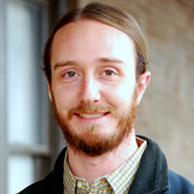
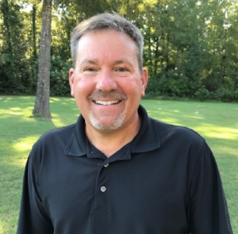
Our Staff
Ashleigh Story
Health Education Coordinator
Steve Powell
Health Outreach Coordinator
Jeremy Adams
DUFB Project Manager

Slide 8
Board of Directors
Sarah Powell Chair
Jennifer Conner
Chair Elect
Andi Ridgway
Past Chair
Kim Boren
1st Vice Chair
Taniesha
Richardson-Wiley
2nd Vice Chair
Becky Adams
Fiscal Chair
Vanessa Smith Secretary

Slide 10
Strategic Plan

Slide 11
Policy, System & Environment

Slide 12
Arkansas Coalition for Obesity Prevention
Knowledge Sharing
Capacity Building
Community Action
Use evidence-based information to guide health improvement
Distribute health statistics and data reports to foster community priority setting
Collect best practices and success stories to inspire other communities
Develop toolkits and assemble toolboxes
Disseminate lessons learned through newsletters, presentations, exhibits, etc.
Interactive Map, Podcasts, Learning Labs/Webinars
Encourage, support, and enhance partnerships among various stakeholder groups
Initiate and develop programs and trainings that improve health through collaboration among healthcare professionals, policy makers, business leaders, academics, non-government organizations, and consumers
Provide technical assistance and subject matter experts as needed
Mayors Mentoring Mayors, AFMA
Immersion Trainings
Foster positive policy, system, and environment change at the local level
Garner recognition for stepwise progression towards community wellness
Secure public and private funding to support innovation programs
Cast vision for future direction
Growing Healthy Communities, Growing Healthy Classrooms, Double Up Food Bucks

Slide 13
Our Tree

Slide 14
Arkansas Farmers Market Association

Slide 15
Membership Application

Slide 16
Application

